Slide 1


Linux Clusters Institute: HPC Storage: Part 1
J.D. Maloney | Sr. HPC Storage Engineer
National Center for Supercomputing Applications (NCSA)
malone12@illinois.edu
This document is a result of work by volunteer LCI instructors and is licensed under CC BY-NC 4.0 (https://creativecommons.org/licenses/by-nc/4.0/).

Slide 2
Target Audience:
Those involved in designing, implementing, or managing HPC storage systems.
Outline:
Common Storage Concepts and Terms
Storage Related Goals & Requirements
Storage Hardware
Storage Software
Wrap Up

Slide 3
Concepts and Terms

Slide 4
What is Storage?
CPU
Cache
(L1, L2, L3,)
A place to store data. Either temporarily or permanently.
Processor Cache
Fastest access; closest to the CPU; temporary (L1, L2)
System Memory (DRAM)
Very Fast access; close to CPU but not on it; temporary
Solid State Storage
Fast access (esp. random)
Can be internal or part of an external storage system
Capable of high densities with high associated costs
Spinning Disk
Slower; performance is tied to access behavior
Can be internal or part of an external storage system
Capable of extremely high densities
Network / Cloud storage
Network - Can scale from slow to extremely fast, high density
Tape
Extremely slow; typically used for cold storage
Memory
(DRAM, HBM, )
Bandwidth Increase
Latency & Size Increase
Solid State Disk
(SATA SSD, M.2 Module, PCIe Card)
Spinning Disks
(PMR, SMR, HAMR/MAMR)
Tape
(LTO, TS11XX)

Slide 5
Concepts and Terms
Throughput: Storage capability usually measured in GB/s (or TB/s)
IOPs: Input/Output Operations per second
RAID: Redundant Array of Independent Disks
JBOD: Just a Bunch of Disks
JBOF: Just a Bunch of Flash
Storage Server: provide direct access to storage device and functions as a data manager for that disk
Storage Client: accesses data, but plays no role in data management
NAS: Network Attached Storage
SAN: Storage Area Network

Slide 6
Concepts and Terms
High Availability (HA)
Components are configured in failover pairs
Prevents a single point of failure in the system
Prevents a service outage
Failover Pairs
Active/Active
Both component share the load
On failure one component takes over the complete load
Active/Passive
One component services requests, the other is in standby
On failure the standby becomes active
Networks
InfiniBand (IB)
Ethernet (TCP/IP)
Host Connectivity
Host Bus Adapter (HBA)
Network Interface Card (NIC)
Storage
Active Controller
Standby Controller
DN
DN
DN
DN

Slide 7
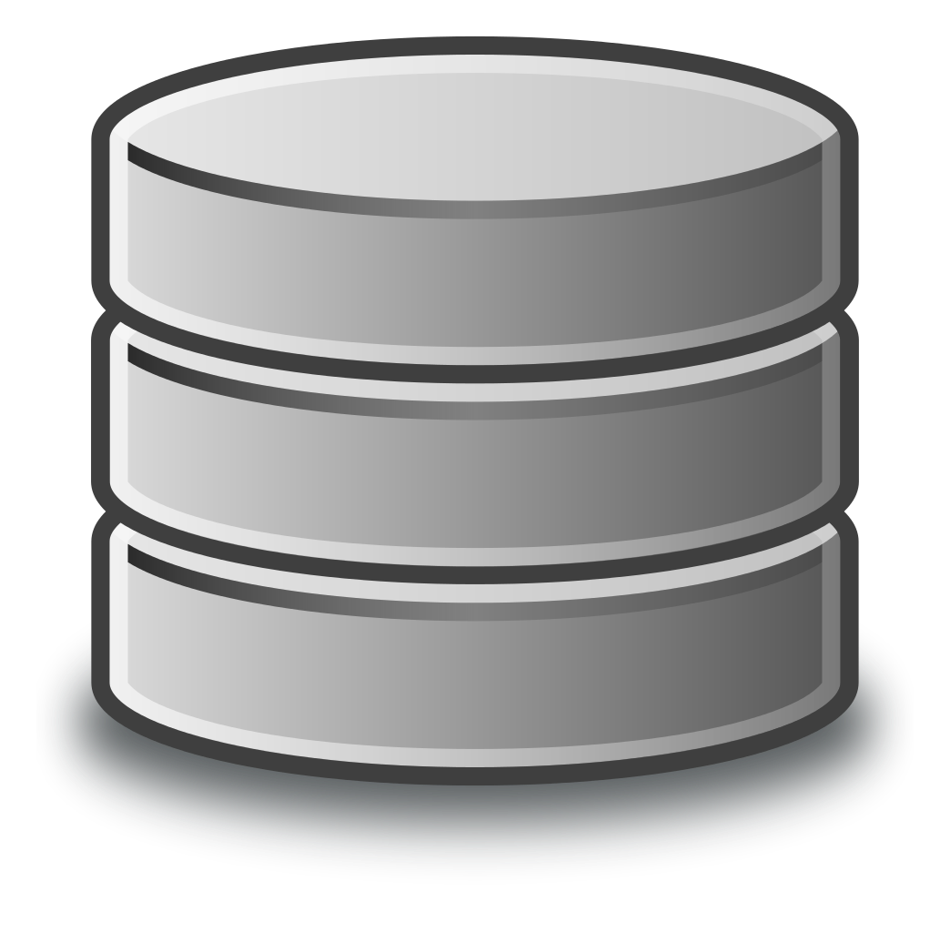
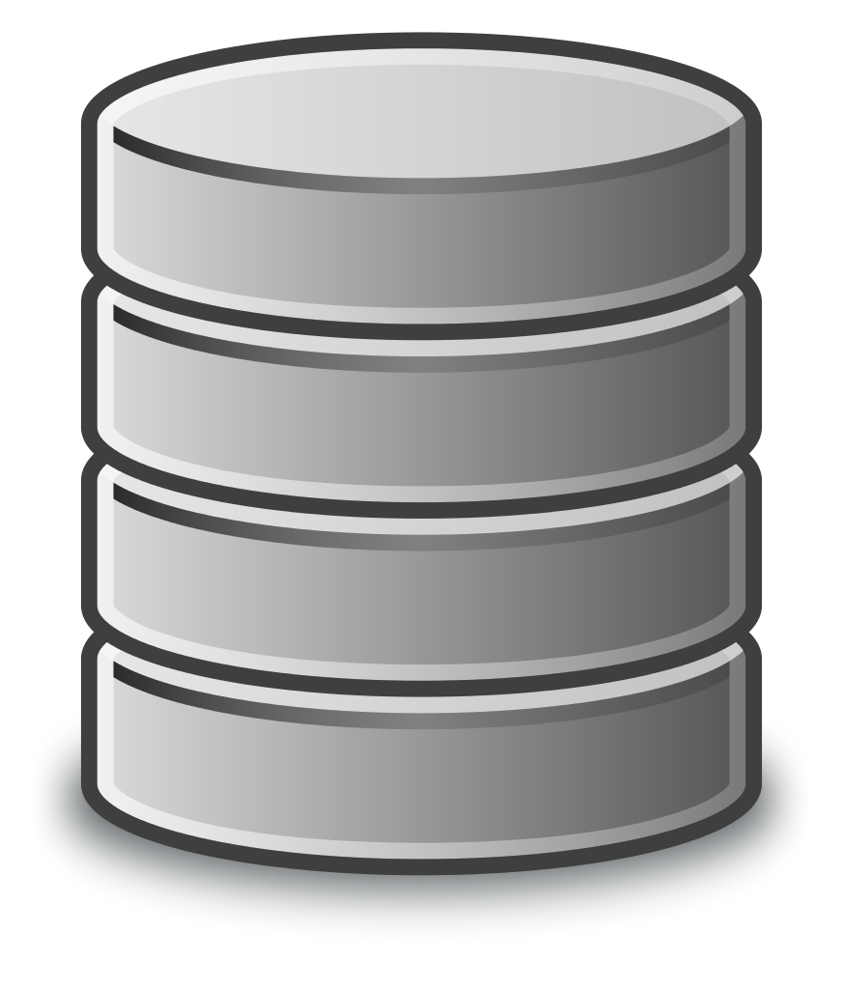
Concepts and Terms
Raw Space: what the disk label shows. Typically given in base 10.
10TB (terabyte) == 10*10^12 bytes
Useable Space: what `df` shows once the storage is mounted. Typically given in base 2.
10TiB (tebibyte) == 10*2^40 bytes
Useable space is often about 25% smaller than raw space
Depending on the RAID level you are selecting, some storage is used for RAID overhead, file system overhead, etc.
Learning how to calculate this is a challenge
Dependent on levels of redundancy and the file system you choose
3 Drives
2 Storage Drives
1 Parity Drive
33% RAID overhead
4 Drives
3 Storage Drives
1 Parity Drive
25% RAID overhead
File System overhead is applied after RAID overhead further reducing the usable space.

Slide 8
Goals and Requirements

Slide 9
How to Choose the Optimal Storage Solution?
Short Answer: Whichever solution meets your requirements
Long Answer: There is no single best solution for all scenarios
Each is designed to solve specific problems and serve specific requirements
Each works well when built and deployed according to their strengths
Usage requirements and access patterns define which is the best choice
Application Requirements
User Expectations
Budget Constraints
Expertise in the support team
Compromise based on competing needs is almost always the end result

Slide 10
Building a Balanced System
The Ideal:
All components of the system operate in perfect harmony such that speeds & feeds within the system all align perfectly
The Reality:
Competing needs will lead to compromises that cause imbalances in the system.
Common Imbalances:
Capacity is prioritized over bandwidth; the number of disks exceeds the performance capabilities of the controllers, disk interconnect, or HBAs
Overall output of the storage system is exceeded by the network capacity of the computational systems

Slide 11
Requirements Evaluation
Stakeholders
Computational Users
Management
Policy Managers
Funding Agencies
System Administration Staff
Infrastructure Support Staff
IT Security Staff
Usage Patterns
Write dominate
Read dominate
Streaming I/O vs Random I/O
User Profiles
Expert vs. Beginner
Custom vs. Commercial application
I/O Profiles
Serial I/O
Random I/O
Parallel I/O
MapReduce I/O
Large Files
Small Files
Infrastructure Profile
Integrated with HPC resource
Standalone storage solution
Network connectivity
Security requirements

Slide 12
Gathering Stakeholder Requirements
Who are your stakeholders?
What features are they looking for?
How will people want to use the storage?
What usage policies need to be supported?
From what science/usage domains are the users?
What applications will they be using?
How much space do they anticipate needing?
Are there expectations of access from multiple systems?
What is the distribution of files?
Sizes, count
What is the typical I/O pattern?
How many bytes are written for every byte read?
How many bytes are read for each file opened?
How many bytes are written for each file opened?
Are there any system-based restrictions?
POSIX conformance - do you need a POSIX interface to the file system
Limitations on number of files or files per directory
Network compatibility (IB, Eth, Slingshot)

Slide 13
Application I/O Access Patterns
An application’s I/O transaction size, and the order in which they are accessed, defines an application’s I/O access pattern. This is a combination of how the application does I/O along with how the file system handles I/O requests.
For typical HPC file systems, sequential I/O of large blocks provides the best performance. Unfortunately, these types of I/O patterns aren’t the most common.
Understanding the I/O access patterns of your major applications can help you design a solution your users will be happy with.

Slide 14
Common Data Access Patterns
Streaming (bandwidth centric)
Records Accessed Only Once, file is read/written from beginning to end
Minimal overall IOPS
File tend to be large and performance is measured in bandwidth
Common in Digital Media, Classic HPC, Scientific Applications, DSP
Discrete File I/O (IOP centric)
Small individual transactions; may not even read a full block at a time
Small files, random access
File IOPS can be high
Common in bioinformatics, AI, /home and /sw directories
Transaction Processing (IOP centric)
Small transactions with good temporal locality; individual updates maybe smaller than a block but consecutive transactions tend to be in continuous blocks
File IOPS can be high
Common in databases and commercial applications

Slide 15
HPC I/O Access Patterns
Traditional HPC
Streaming large block writes (low IOPs rates)
Large output files
Minimal metadata operations
More common today
Random I/O patterns (high IOPs rates)
Smaller output files
Large number of metadata operations
Challenges:
Choosing a block size that fits your application I/O pattern
IOPs becomes more important with random I/O patterns and small files

Slide 16
Gathering Data Requirements
Do you need different tiers or types of storage?
Active long-term (project space)
Temporary (scratch space, fast, not backed up)
Archive (cloud, disk or tape, cheaper)
Backups (snapshots, disk, tape)
Encryption (SED or per share/export)
Data Restrictions
HIPAA and PHI
CUI
PCI DSS
And many more (FISMA, ITAR, SOX, GLBA, CJIS, FERPA, SOC, …)
Data transfer characteristics

Slide 17
Training and Support Requirements
Training
Sys Admin Staff
How much training does your staff need?
Vendor supplied training?
Does someone on your staff have the expertise to provide training?
User Services
How much training does user support staff need?
Does your user support staff have the expertise to provide user training?
Users
How much training will your users need to effectively use the system?
How often will training need to be provided?
System Support
Does the vendor provide support for all components of your system?
Does support for parts of your system come from the open source community?
What are the support requirements for your staff?
7x24
8x5 M-F
Do you have Service Level Agreements (SLAs) with your user community?

Slide 18
Storage Hardware

Slide 19
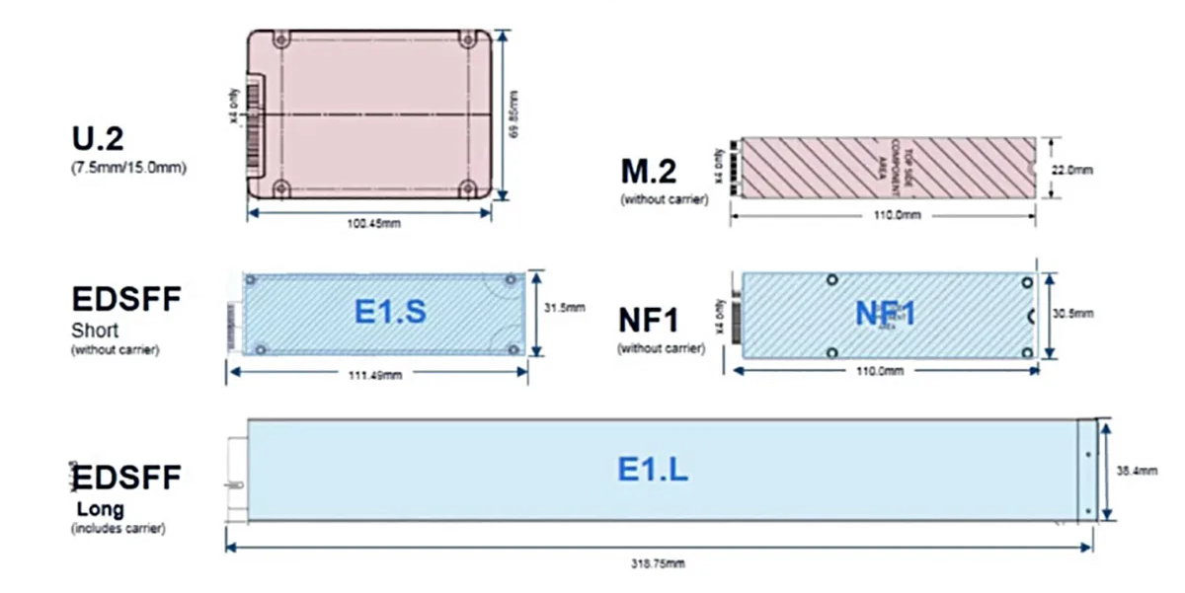
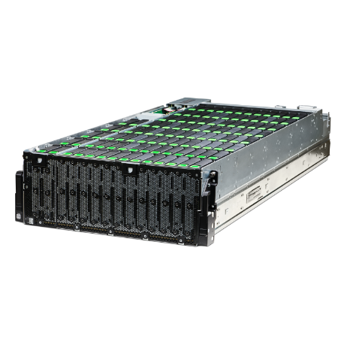
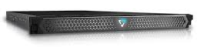
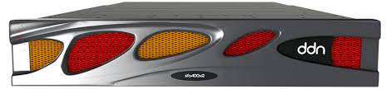
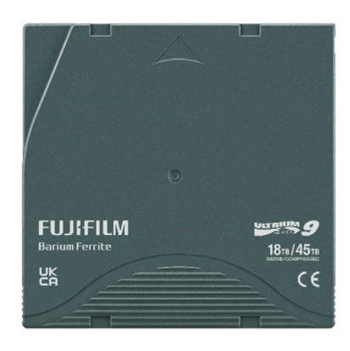
Common Storage Building Blocks
Media
HDDs (SATA & SAS)
SSDs (SATA, SAS, NVMe)
Tape (LTO, TS11XX)
Media Formats
HDD - 3.5” (2.5” dying out, some 10/15K SAS remain)
SSD - 2.5” (varying thicknesses), U.2/3, E1.S/L, E3.S/L, M.2
Tape - LTO (Open Standard), TS11XX (IBM format)
Enclosures
JBOD & JBOF (Enclosures/Drawers)
Controller (Couplets)
Storage Servers

Slide 20
Common Connecting Fabrics
Network Fabrics
Ethernet
Speeds: 1Gb - 400GbE (800GbE soon)
RJ-45, SFP+, QSFP+, QSFP-DD
TCP/RoCE
Infiniband
EDR, HDR, NDR (100Gb, 200Gb, 400Gb) are modern versions in used today
RDMA support
Slingshot
HPE specific (at present)
Ethernet based with “extra stuff”
Other Storage Fabrics & Carriers
Fiber Channel & SAS
24Gb SAS is now GA; 12Gb still common
64GFC is now available (6.4GB/s per direction)
PCIe
Gen 5 (32GT/s per lane) ~64GB/s per direction in a x16 slot (available in 2023)
Gen 4 (16GT/s per lane) ~32GB/s per direction in a x16 slot (available since 2019)
Carrier for CXL devices, NVME drives, NICs, etc.
Gen 6 (64GT/s per lane) ~128GB/s per direction in a x16 slot -- likely 2025/2026 GA

Slide 21
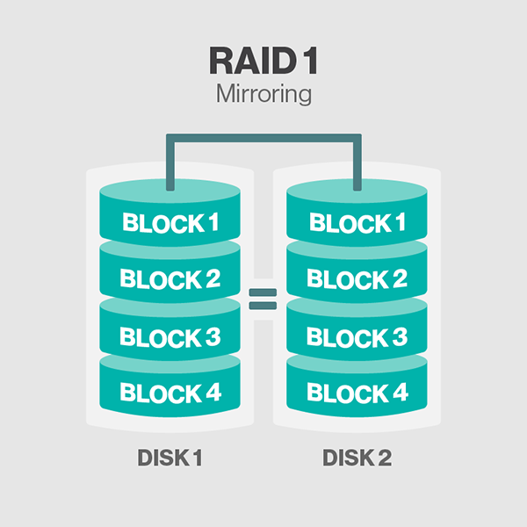
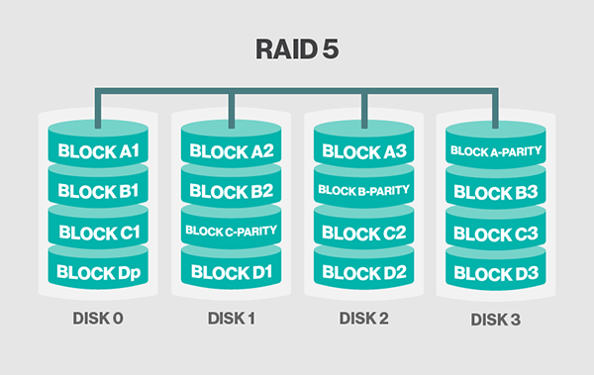
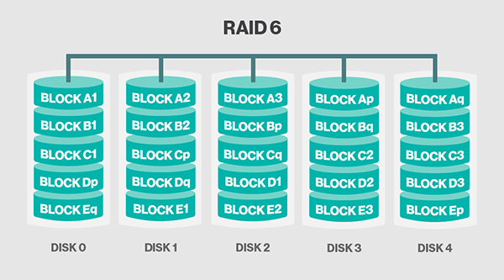
Common RAID Levels
Standard Levels
RAID 0: striping without mirroring or parity
RAID 1: data mirroring, without parity or striping
RAID 5: block-level striping with distributed parity
No loss of data with a single disk failure
Performance hit in degraded mode
RAID 6: block-level striping with dual distributed parity
No loss of data with two disk failures
Data loss occurs with third failure
Most common in larger systems today
Hybrid Levels
RAID 0+1: create two stripes then mirror
RAID 1+0: striping across mirrored drives

Slide 22
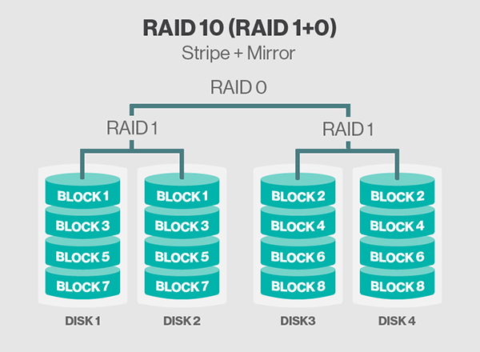
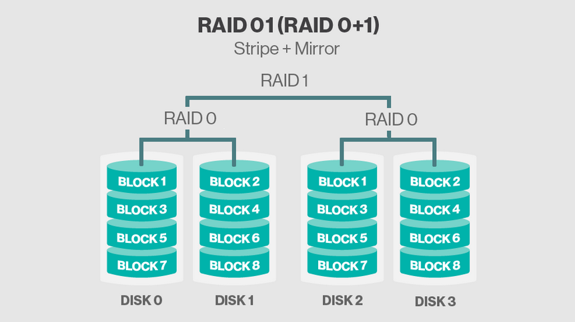
Common RAID Levels (cont.)
Hybrid Levels
RAID 0+1: create two stripes then mirror
RAID 1+0: striping across mirrored drives

Slide 23
Erasure Coding
RAID levels are becoming/already are not tenable with increasing drive sizes and performance characteristics
Capacity of drives have outpaced their performance capabilities
Increased rebuild times mean we need a faster way to get data protected following device failure
RAID rebuilds typically require the new drive to do a write of its entire capacity once, creates a write bottleneck on one device
This is leading to the use of erasure coding across many devices to greatly shorten the time to data protection
There are different erasure algorithms, but most operate on a common principles

Slide 24
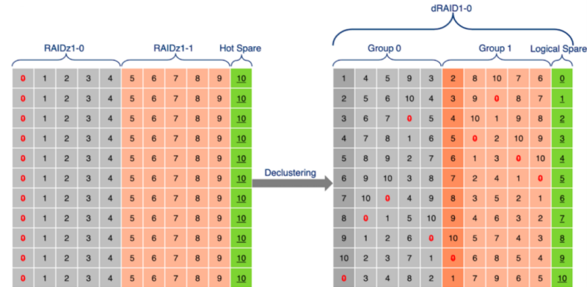
Erasure Coding
An example with ZFS dRAID
May not seem much different on the surface but much more resilient than classic RAID methods

Slide 25
Erasure Coding
Improvements over “classical RAID”
All drives in the pool participate in a rebuild, can even happen if drive not replaced (depends on solution/configuration)
Reconstruction of data can be ordered more efficiently, rebuild the most critical blocks first and move to the least critical
Large erasure code pools (especially/primarily) on fast media can have seriously increased usage efficiency without losing data protection
No more rebuild bottleneck on a single drive
Some (not exhaustive) list of solutions that use erasure coding
Ceph
ZFS dRAID
DDN SFA
VAST Data
IBM ESS

Slide 26
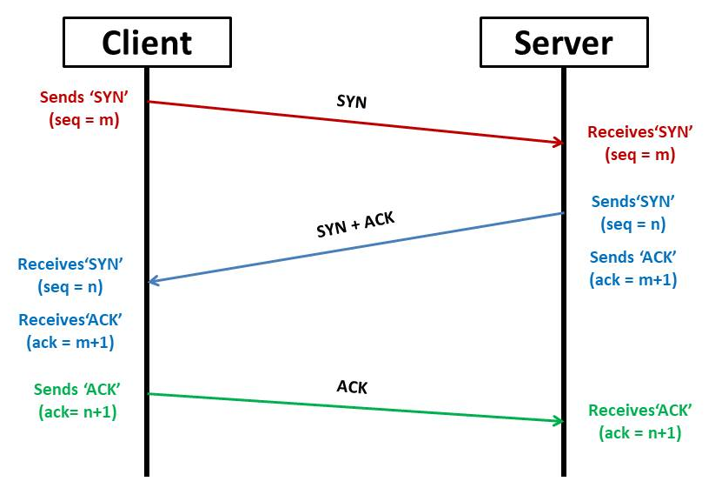
Data Transport from Server to Client
TCP (Transmission Control Protocol)
Great for the Internet and viewing cat videos, sub-optimal for high performance storage transport
Very robust method of moving data to ensure it gets there no matter what and is resilient in poor conditions
Parallel file systems are getting better at optimizing for standard Ethernet connections and TCP
Data has to flow through OS (it’s buffers), to the NIC (and its buffers), over the network to the other host and traverse the same stack again in reverse order

Slide 27
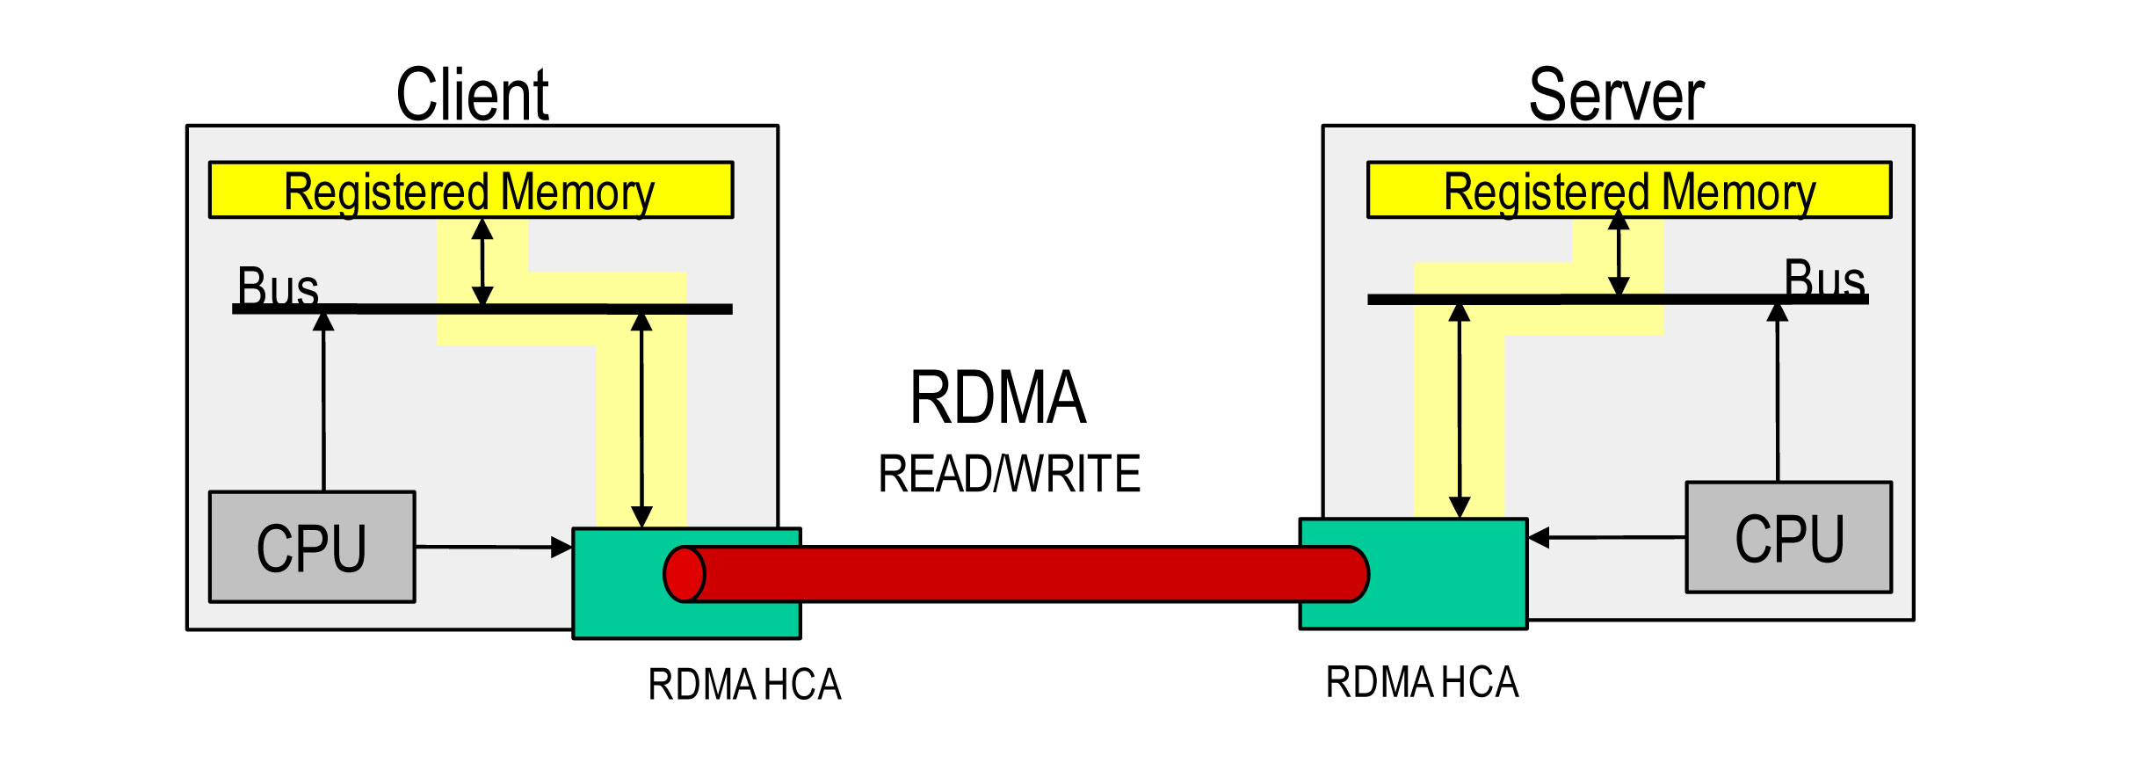
Data Transport from Server to Client
RDMA (Remote Direct Memory Access)
Requires a “lossless” network be that Infiniband, RoCE, Slingshot, etc.
Applications can transfer data from their memory to memory on a remote host directly, bypassing a lot of the layers in the stack
Improves both throughput of file systems between servers and clients as well as reduces latency which greatly helps metadata-intensive workloads as well as though that do many small I/O transactions

Slide 28
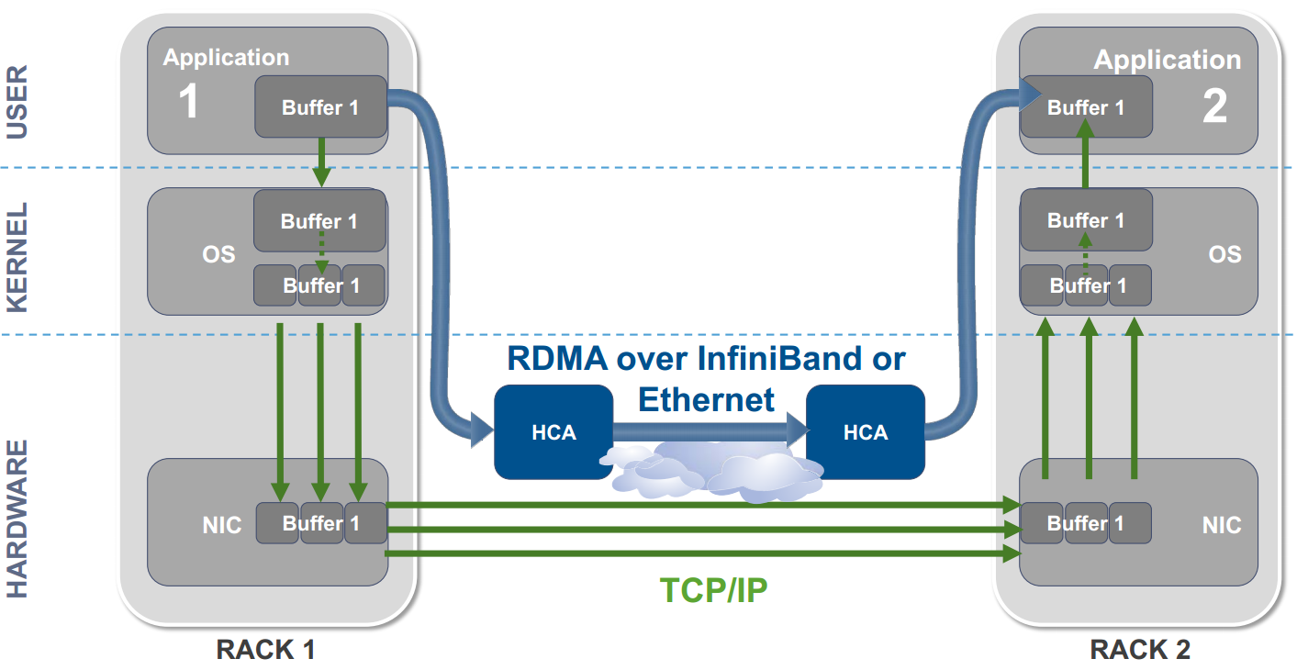
TCP vs. RDMA

Slide 29
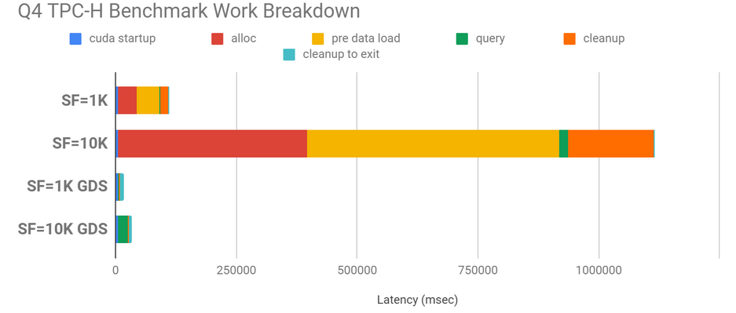
Data Transport from Server to Client
GDS (GPU Direct Storage)
Allows storage traffic to by-pass the host CPU and Memory and copy straight into VRAM on the GPU
As network speeds and all-flash appliance speeds increase, it cuts out a bottleneck between your file system and getting data into the GPU’s memory for training/processing
Works with Nvidia GPUs and a lot of different storage platforms
If you have GPUs and need to buy storage, check if storage solution supports GDS
Formerly known as Magnum IO (in case you see that in docs)

Slide 30
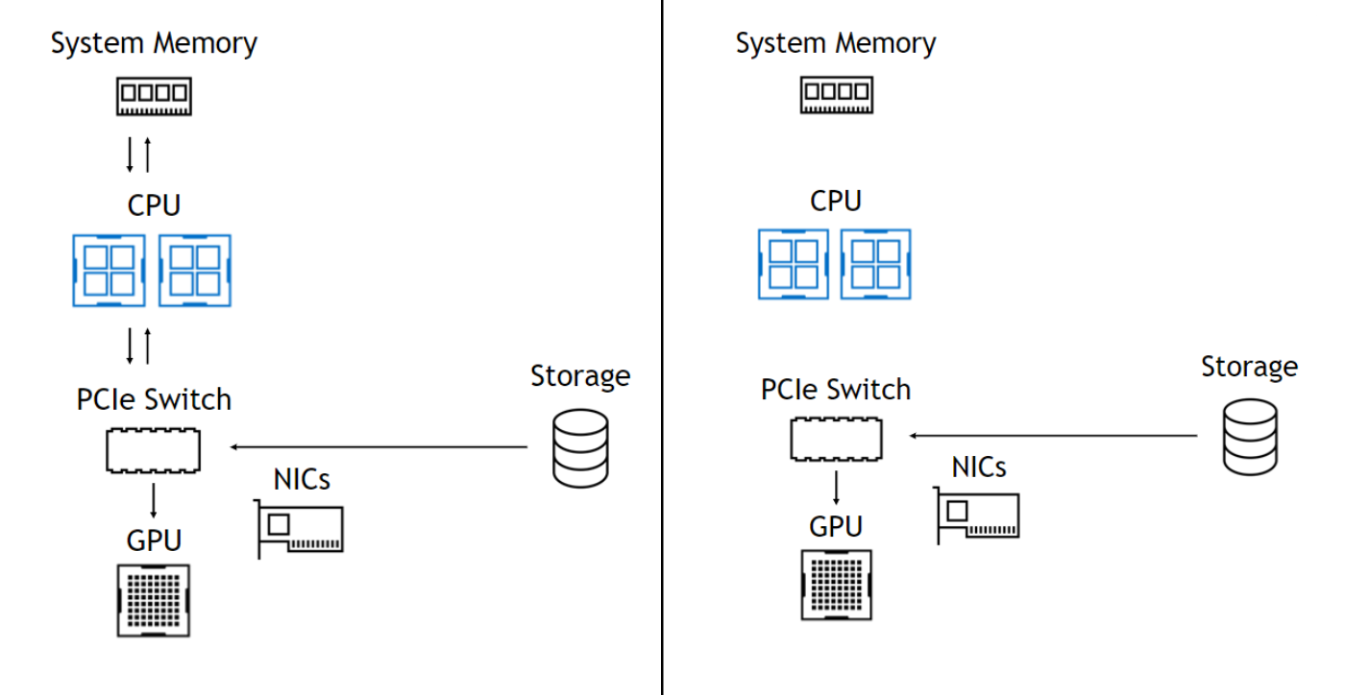
GDS (GPU Direct Storage)

Slide 31
Storage Software

Slide 32
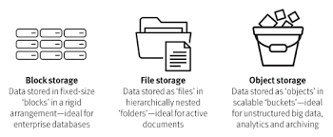
File vs. Object Storage
File Storage
A block holds a chunk of data, files typically reside in multiple blocks.
Data is accessed through a request to the block address
The file system controls access to blocks, imposes a hierarchical structure and defines and updates metadata
File systems are generally POSIX compliant
Access is through the OS layer, user has direct access to the file system
Storage systems are generally feature rich and externally based
Raw block storage is common in large scale database applications allowing direct block access
Object Storage
An object hold both data and it’s associated metadata
Data is access through a request for the object ID
Objects are stored in a flat structure
Metadata can be flexible and defined by the user
Resiliency is provided through multiple copies of the object, generally geographically distributed
Access is through a REST API application not the OS
Systems are generally built with commodity servers with internal disks

Slide 33
Data Consistency
Strong Consistency
Block storage systems are strongly consistent
Typically used for real-time processing such as transactional databases
Good for data that is constantly changing
Updating a file only requires changing the blocks that have changed
Limited scalability especially within a geographically distributed system
Guarantees that a read request returns the most recent version of data
Eventual Consistency
Some object storage systems are eventually consistent
High availability for data that is relatively static and rarely altered
Updating an object requires a re-write of the entire object
Typical uses are for multimedia or unstructured data
There is no guarantee that a read request returns the most recent version of data

Slide 34
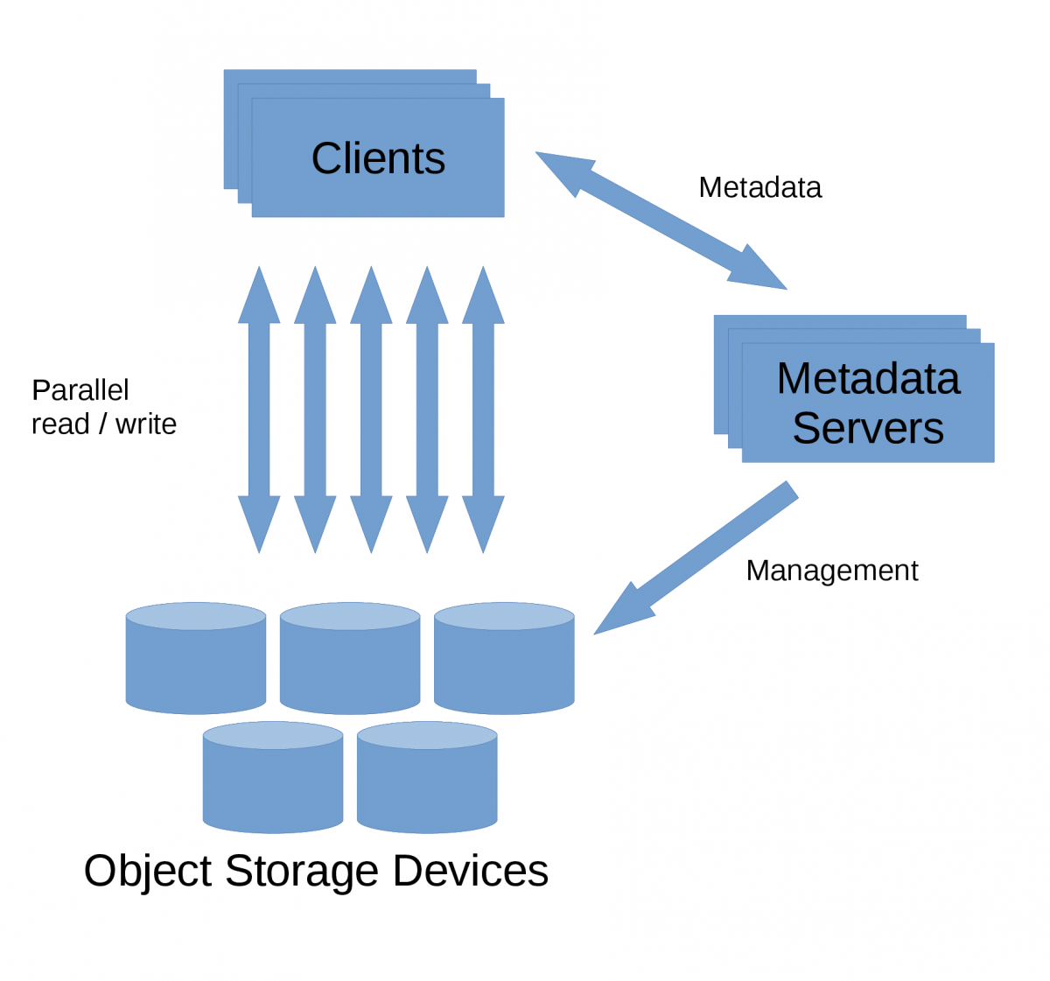
Parallel vs. Non Parallel File Systems
Characteristics of a Parallel File System
Multiple storage servers manage a single namespace
Speed is able to be increased by scaling up the number of storage servers and the disks they present
Handle consistent locking across files and directories being accessed from multiple clients at the same time
Characteristics of Non-Parallel File Systems
Usually limited to a single storage server
Often file systems just accessed by the local machine (XFS, EXT4, etc.)
Can present multiple clients over a network, but don’t/can’t enforce full POSIX locking compliance across all of them

Slide 35
Why HPC Uses Parallel File Systems
Clusters are made up of many nodes (10s, 100s, 1000s of nodes)
Single jobs can run and span many/all of these nodes in the system and will need access to the same data
HPC jobs also may involve checkpointing and will need a shared file system to store checkpoint files
HPC systems generally work with and produce large amounts of data that can quickly/easily scale beyond the capability of since servers
The immense compute power of these machines need fast file systems to keep them “fed” with data

Slide 36
Goals of Scale-Out File Systems
Access Transparency: clients are unaware that they are access remote data
Concurrency Transparency: all clients have the same view of the data state
Failure Transparency: clients continue to operate correctly after a server failure
Heterogeneity: clients/servers can be of different hardware and operating system
Scalability: file system should work as well at small client node counts as at large client node counts
Replication Transparency: any data replication should be invisible to clients
Migration Transparency: any data migration should be invisible to clients

Slide 37

Some Examples of File Systems Used in HPC
Characteristics
Open source parallel distributed file system
Metadata services and storage are segregated from data services and storage
System Components
Metadata Servers (MDS) – metadata servers, client access is through the MDS
Metadata Targets (MDT) – dedicated metadata storage
Management Servers (MGS) – Lustre cluster management
Management Targets (MGT) – management data storage
Object Storage Servers (OSS) – data servers, client access is through the OSS
Object Sever Targets (OST) – dedicated object storage
Sources
lustre.org – community support for Lustre source
Productized by companies such as DDN and HPE (and others)

Slide 38
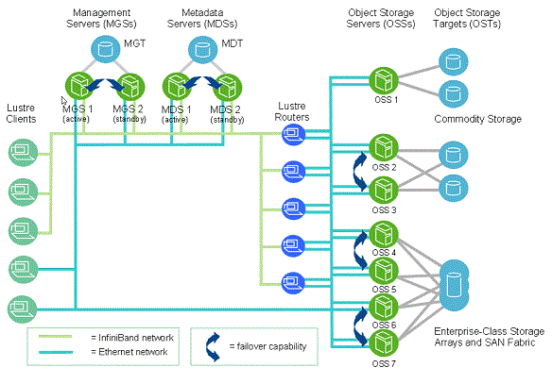
Some Examples of File Systems Used in HPC

Slide 39

Some Examples of File Systems Used in HPC
Characteristics
All user data is accessible from any disk to any node
Metadata may be shared from all disks or from a dedicated set of disks
Supports multi copies of metadata
All data movement between nodes and disk is parallel
Large number of nodes utilize the file system
System Components
Server Nodes - Cluster Manager, Quorum Nodes, File System Manager
NSD Servers – direct or SAN attached to physical storage, block access
Network Shared Disk (NSD) – LUNs formatted for GPFS usage
Sources
IBM – https://www.ibm.com/products/spectrum-scale

Slide 40
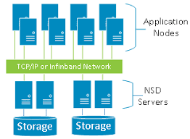
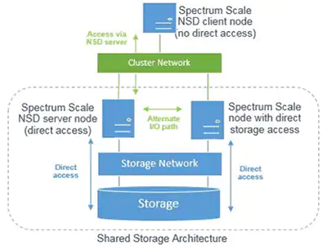
Some Examples of File Systems Used in HPC

Slide 41

Some Examples of File Systems Used in HPC
Characteristics
Generally separate metadata and data servers/services
Scale out metadata and data
Newly has a policy engine called BeeGFS Hive Index
Like Lustre built to run well on commodity hardware
System Components
Metadata Server/Service - Provides metadata information to clients about inodes
Data Server/Service – Stores the files themselves and retrieves them for clients
Management & Monitoring Service - Holds cluster configuration needed by clients and provides monitoring functions for the cluster
Sources
BeeGFS – https://doc.beegfs.io/

Slide 42
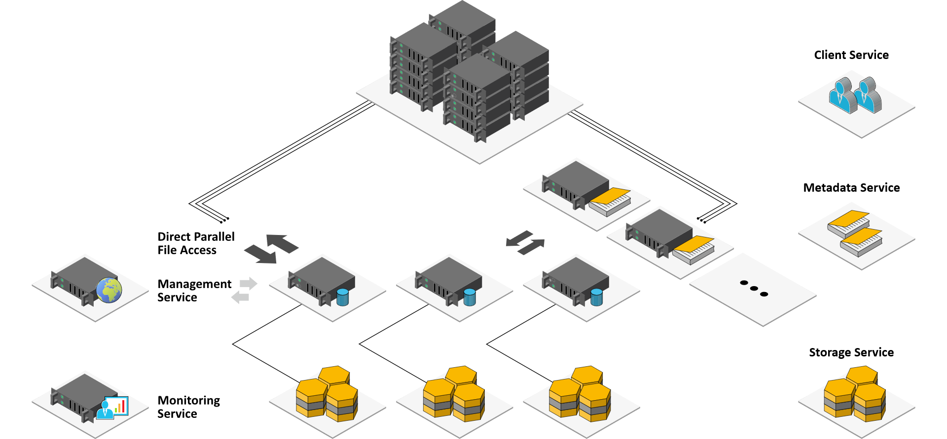
Some Examples of File Systems Used in HPC

Slide 43

Some Examples of File Systems Used in HPC
Characteristics
Leverages NFS for clients (can use ”stock” NFS but really needs to use a custom NFS client provided by VAST)
Scale out and scale up to get more capacity and performance
Has built in data compression and dedupe (aka. “data reduction”)
Focuses on Read performance over Write performance
System Components
D-Boxes - “Disk Boxes” that present media devices to the C-Boxes
C-Boxes - “Compute Boxes”/”C-Nodes machines that form the file system and present it to clients via NFS, SMB, S3
Backend Fabric - Ethernet or IB fabric between the C-Boxes and D-Boxes
Sources
VAST – https://vastdata.com

Slide 44
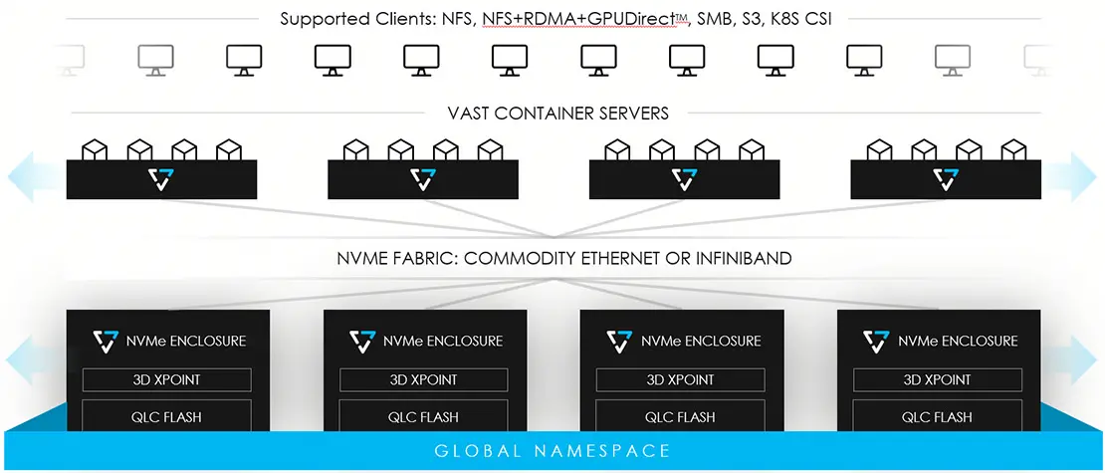
Some Examples of File Systems Used in HPC

Slide 45
Common HPC Storage Solutions
Lustre Appliances
DDN EXAScaler
HPE Cray Sonexion
Dell/EMC HPC Lustre Storage
Spectrum Scale Appliances
IBM ESS
Lenovo GSS
Dell Pixstor
HPE Enterprise Storage
BeeGFS Reference Solution Providers
NetApp
Dell
BeeGFS (cont.)
RAID Inc.
Exxact Corp.

Slide 46
Other Storage Solutions Seen in HPC
There are some other storage solutions/vendors out there, that while not large, do show up regularly enough at HPC sites that they’re worth mentioning:
CephFS
Quobyte
ZFSonLinux + NFS/SMB
Swift
Panasas
Pure Storage
NetApp (NFS)

Slide 47
Resources
HPC:
https://www.youtube.com/watch?v=n0OfAoUXUJw (Henry Neeman) Supercomputing in plain English
General Storage:
https://www.youtube.com/watch?v=pBmtY4Tk-R8 (Henry Neeman) Why storage for big data is hard
Hardware Related:
https://docs.nvidia.com/gpudirect-storage/overview-guide/index.html GPU Direct Storage
https://www.geeksforgeeks.org/remote-direct-memory-access-rdma/ RDMA
https://www.snia.org/forums/cmsi/knowledge/formfactors Flash form factors
https://en.wikipedia.org/wiki/InfiniBand Generations of Infiniband
https://www.lto.org/lto-generation-compatibility/ LTO Tape Generation & Compatibility Information

Slide 48
Resources
Tuning and Benchmarking:
fasterdata.es.net/ An Expert Guide for End-to-End Performance Tuning, Tools and Techniques
https://ior.readthedocs.io/en/latest/ IOR and mdtest documentation
https://github.com/breuner/elbencho Another FS benchmarking tool with GDS Support
https://glennklockwood.blogspot.com/2016/07/basics-of-io-benchmarking.html
File System Solutions:
www.opensfs.org/ OpenSFS supports vendor-neutral development of Lustre
wiki.lustre.org Lustre Wiki
https://www.ddn.com/products/lustre-file-system-exascaler/ DDN Exascaler
www.ibm.com/products/spectrum-scale IBM Spectrum Scale
www.spectrumscale.org Spectrum Scale User Group
https://docs.ceph.com/en/quincy/ CEPH file system
https://vastdata.com VAST

Slide 49
Resources
File System Solutions:
https://thelinuxcluster.com/2012/10/18/a-brief-look-at-the-difference-between-nfsv3-and-nfsv4/ NFSv3 vs NFSv4
https://zfsonlinux.org ZFS Main Page
https://openzfs.github.io/openzfs-docs/Project%20and%20Community/Mailing%20Lists.html ZFS Mailing Lists

Slide 50
Questions?

